Slide 1
THE LIFE OF CHRIST
PART 9

Slide 2
Luke 4:1 Then Jesus, being filled with the Holy Spirit, returned from the Jordan and was led by the Spirit into the wilderness, ² being tempted for forty days by the devil. And in those days He ate nothing, and afterward, when they had ended, He was hungry. ³ And the devil said to Him, "If You are the Son of God, command this stone to become bread." ⁴ But Jesus answered him, saying, "It is written, 'Man shall not live by bread alone, but by every word of God.' " ⁵ Then the devil, taking Him up on a high mountain, showed Him all the kingdoms of the world in a moment of time. ⁶ And the devil said to Him, "All this authority I will give You, and their glory; for this has been delivered to me, and I give it to whomever I wish.

Slide 3
⁷ "Therefore, if You will worship before me, all will be Yours." ⁸ And Jesus answered and said to him, "Get behind Me, Satan! For it is written, 'You shall worship the LORD your God, and Him only you shall serve.' " ⁹ Then he brought Him to Jerusalem, set Him on the pinnacle of the temple, and said to Him, "If You are the Son of God, throw Yourself down from here. ¹⁰ "For it is written: 'He shall give His angels charge over you, To keep you,' ¹¹ "and, 'In their hands they shall bear you up, Lest you dash your foot against a stone.' " ¹² And Jesus answered and said to him, "It has been said, 'You shall not tempt the LORD your God.' " ¹³ Now when the devil had ended every temptation, he departed from Him until an opportune time.

Slide 4
Luke 4:1 Then Jesus, being filled with the Holy Spirit, returned from the Jordan and was led by the Spirit into the wilderness, ² being tempted for forty days by the devil.

Slide 5
And in those days He ate nothing, and afterward, when they had ended, He was hungry.

Slide 6
³ And the devil said to Him, "If You are the Son of God, command this stone to become bread."

Slide 7
But Jesus answered him, saying, "It is written, 'Man shall not live by bread alone, but by every word of God.' "

Slide 8
Psalm 119:11 Your word I have hidden in my heart, That I might not sin against You!

Slide 9
Job 23:12 I have not departed from the commandment of His lips; I have treasured the words of His mouth More than my necessary food.
Psalm 19:9 The fear of the LORD is clean, enduring forever; The judgments of the LORD are true and righteous altogether. ¹⁰ More to be desired are they than gold, Yea, than much fine gold; Sweeter also than honey and the honeycomb.
1 Peter 2:2 as newborn babes, desire the pure milk of the word, that you may grow thereby,

Slide 10
⁵ Then the devil, taking Him up on a high mountain, showed Him all the kingdoms of the world in a moment of time. ⁶ And the devil said to Him, "All this authority I will give You, and their glory; for this has been delivered to me, and I give it to whomever I wish. ⁷ "Therefore, if You will worship before me, all will be Yours."

Slide 11
⁸ And Jesus answered and said to him, "Get behind Me, Satan! For it is written, 'You shall worship the LORD your God, and Him only you shall serve.' "

Slide 12
2 Corinthians 11:14 And no wonder! For Satan himself transforms himself into an angel of light. ¹⁵ Therefore it is no great thing if his ministers also transform themselves into ministers of righteousness, whose end will be according to their works.

Slide 13
" ⁹ Then he brought Him to Jerusalem, set Him on the pinnacle of the temple, and said to Him, "If You are the Son of God, throw Yourself down from here. ¹⁰ "For it is written: 'He shall give His angels charge over you, To keep you,' ¹¹ "and, 'In their hands they shall bear you up, Lest you dash your foot against a stone.' "

Slide 14
¹² And Jesus answered and said to him, "It has been said, 'You shall not tempt the LORD your God.' "

Slide 15
¹³ Now when the devil had ended every temptation, he departed from Him until an opportune time.

Slide 16
1 John 2:16 For all that is in the world -- the lust of the flesh, the lust of the eyes, and the pride of life -- is not of the Father but is of the world.

Slide 17
Hebrews 4:15 For we do not have a High Priest who cannot sympathize with our weaknesses, but was in all points tempted as we are, yet without sin. ¹⁶ Let us therefore come boldly to the throne of grace, that we may obtain mercy and find grace to help in time of need.

Slide 18
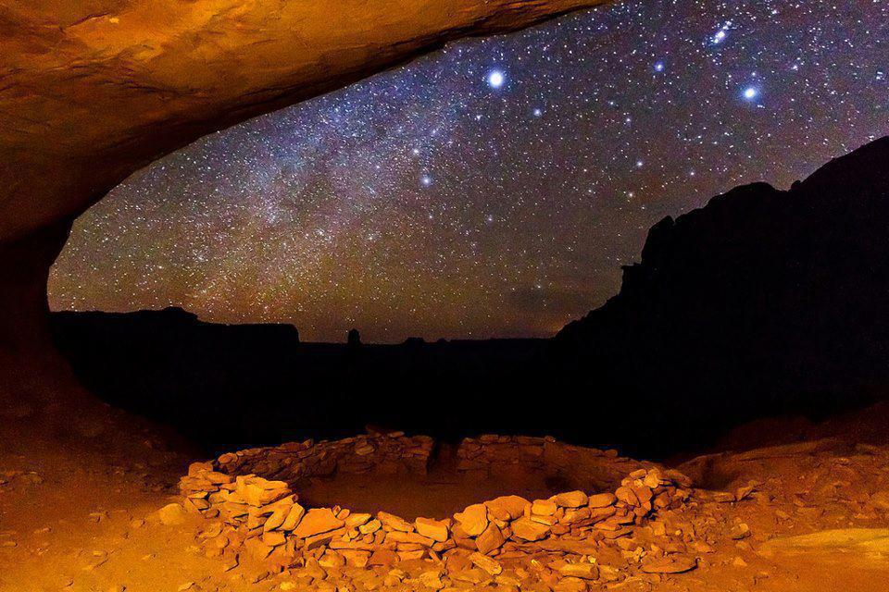
John 1:19 Now this is the testimony of John, when the Jews sent priests and Levites from Jerusalem to ask him, "Who are you?" ²⁰ He confessed, and did not deny, but confessed, "I am not the Christ." ²¹ And they asked him, "What then? Are you Elijah?" He said, "I am not." "Are you the Prophet?" And he answered, "No."

Slide 19
“Are you Elijah?” They thought the Scriptures foretold that Elijah would be resurrected and sent back as a forerunner for the coming Messiah (Mal. 4:5-6). Notice, John said, no I am not him. However, Jesus said that he was Elijah (Mk. 9: 11-13; Mt. 11:13-14). Is this a contradiction? Jesus said he was Elijah, but John said he was not. Luke 1:13-17 provides the answer. The forerunner would not be Elijah resurrected, he would only be a person that came in the spirit and the power of Elijah. It is in this sense that John was Elijah. So, there is no contradiction.

Slide 20
“Are you the Prophet?” They knew what the Scriptures said even though they did not fully understand them. There question came from what Moses said in Deuteronomy 18:15-19. However, this prophecy was about Christ (Acts 3:18-22).

Slide 21
John 1:22 Then they said to him, "Who are you, that we may give an answer to those who sent us? What do you say about yourself?" ²³ He said: "I am 'The voice of one crying in the wilderness: "Make straight the way of the LORD," ' as the prophet Isaiah said."

Slide 22
John 1:25 And they asked him, saying, "Why then do you baptize if you are not the Christ, nor Elijah, nor the Prophet?"

Slide 23
John 1:26 John answered them, saying, "I baptize with water, but there stands One among you whom you do not know. ²⁷ "It is He who, coming after me, is preferred before me, whose sandal strap I am not worthy to loose." ²⁸ These things were done in Bethabara beyond the Jordan, where John was baptizing.

Slide 24
John 1:29 The next day John saw Jesus coming toward him, and said, "Behold! The Lamb of God who takes away the sin of the world! ³⁰ "This is He of whom I said, 'After me comes a Man who is preferred before me, for He was before me.' ³¹ "I did not know Him; but that He should be revealed to Israel, therefore I came baptizing with water." ³² And John bore witness, saying, "I saw the Spirit descending from heaven like a dove, and He remained upon Him. ³³ "I did not know Him, but He who sent me to baptize with water said to me, 'Upon whom you see the Spirit descending, and remaining on Him, this is He who baptizes with the Holy Spirit.' ³⁴ "And I have seen and testified that this is the Son of God."

